Slide 1
LECTURE: 8
DICTATORSHIP AND STRUGGLES FOR DEMOCRACY (1947-1971)
PROFESSOR SYED M HASHEMI

Slide 2
OUTLINE: LECTURE 8
Dictatorship and Struggles for Democracy
Learning Objectives:
Recognize that the government of Pakistan from 1947 onwards would always refuse to accommodate the interests of Bengalees
Realize that when civilian governments could not maintain the political and economic domination over the majority Bengalees, they would opt for military dictatorships for control by force and violence rather than provide for democratic rights
Explain how Bengalee nationalism emerged over the years (1948-1971) from successive people’s struggles against the dictatorship and repression of Pakistan
Analyze how democracy and political and economic aspirations of the majority Bengalees could never be allowed within the Pakistan state structure

Slide 3
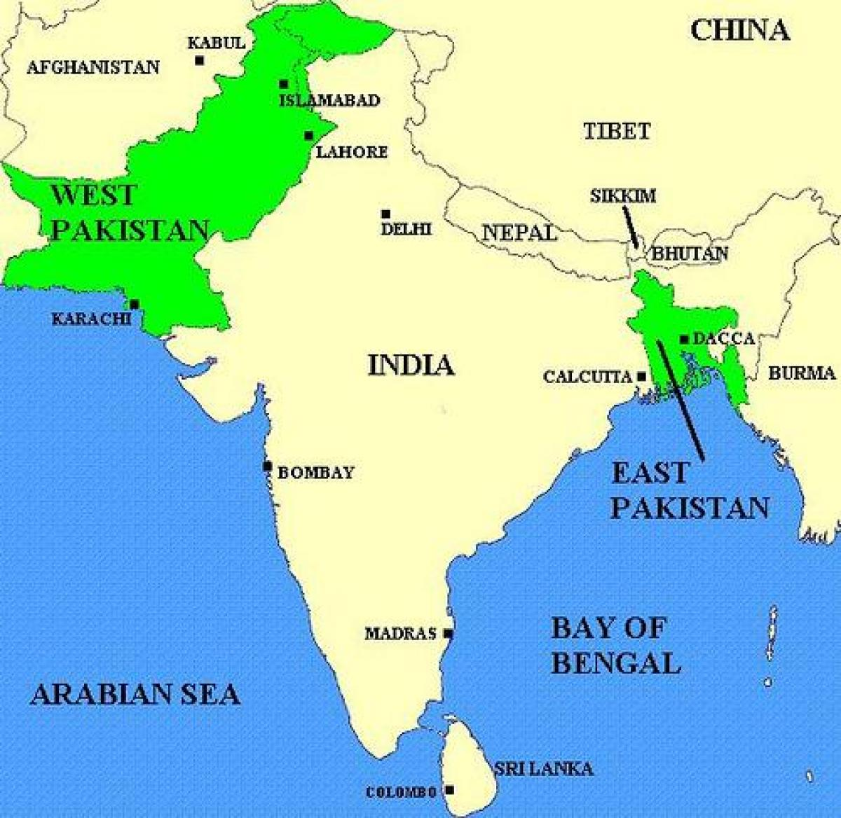
MAP OF PAKISTAN IN 1947

Slide 4
CHALLENGES FOR PAKISTAN
Founded on religious nationalism and fear of domination of Hindu Raj
Two wings with distinctly different languages, ethnicity, history, culture
Two wings separated by a thousand miles of Indian territory
Disparity in the civil bureaucracy: of the 133 Muslim officers of the Indian Civil Service only 1 was Bengali
Disparity in the military: Bengalis constituted less than 3 % of the army
Most wealthy Muslim traders from India settled in WP
Agrarian structure: strong feudal lords in WP, peasant economy in EP
military, bureaucracy, big business, feudal lords, based in WP, constituted the ruling elite in Pakistan

Slide 5
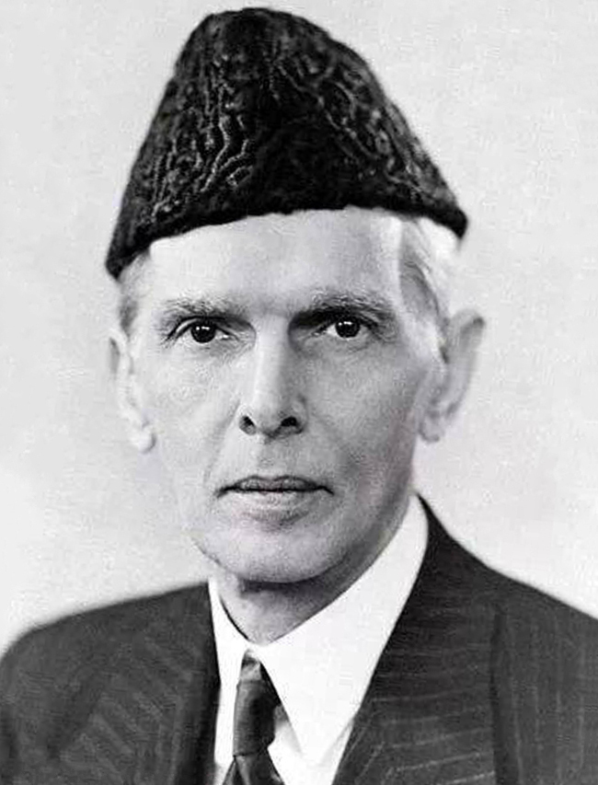
MUHAMMAD ALI JINNAH:
ATTEMPT AT AN ALL PAKISTAN IDEOLOGY
“Urdu and Urdu alone will be the national language of Pakistan”
-Muhammad Ali Jinnah in Dhaka, March 24, 1948

Slide 6
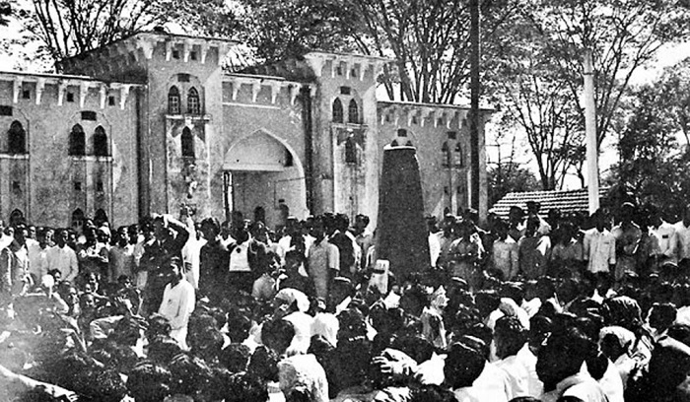
THE LANGUAGE MOVEMENT: 1948-1952

Slide 7
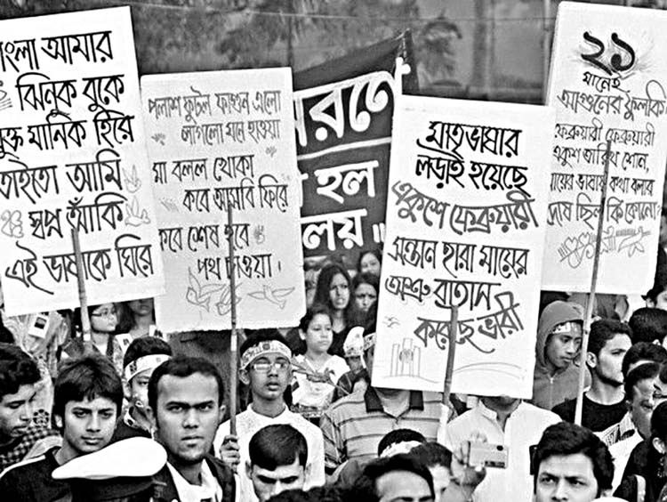
THE LANGUAGE MOVEMENT: 1948-1952

Slide 8
PROVINCIAL ELECTION OF 1954
First election in East Pakistan: universal adult franchise
United Front contested against the Muslim League on 21-point demand
    recognition of Bengali as one of the state languages
    introduce free and universal primary education
    abolish zamindari system and distribute land to peasants
    economic and social rights of industrial workers
    nationalization of the jute industry
    protect country from flood and famine
    army HQ in WP, navy HQ in EP, ordnance factory in EP
Landslide victory of United Front: 228 seats out of 309, Muslim League won only 7 seats

Slide 9
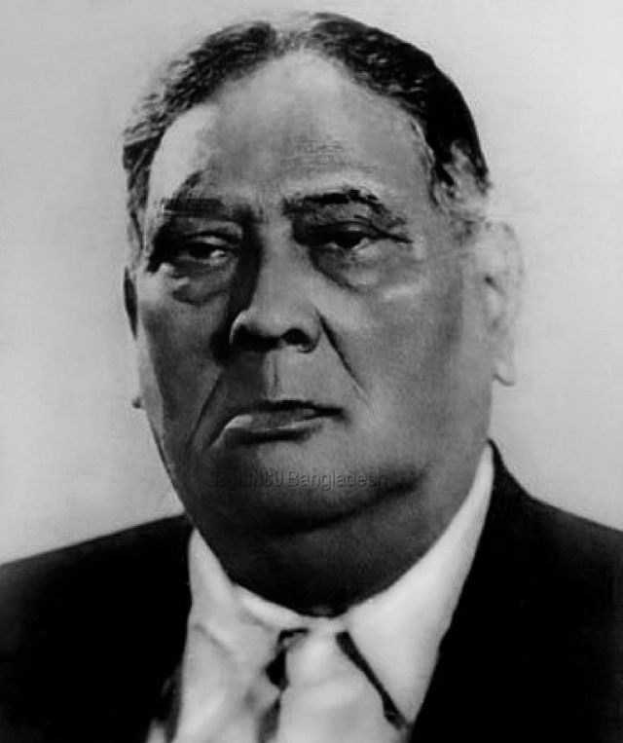
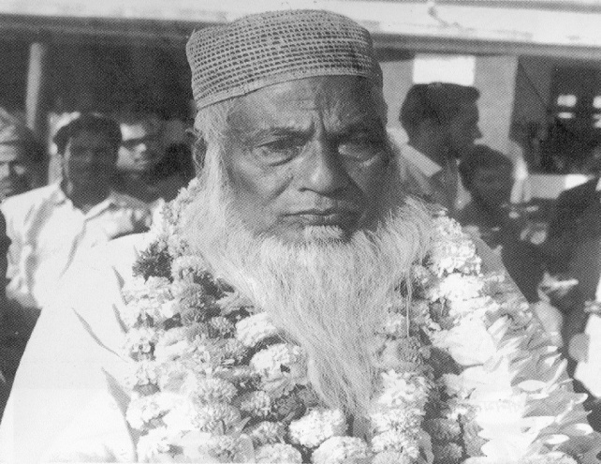
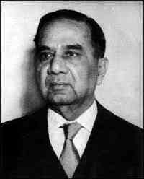
LEADERS OF THE UNITED FRONT
A K Fazlul Huq
Maulana Abdul Hamid
Khan Bhasani
Huseyn Shaheed
Suhrawardy
Jukto Front government dismissed by Governor-General Ghulam Muhammad in a few months

Slide 10
CONSTITUTIONAL COUPS IN PAKISTAN
1953: Governor General Ghulam Muhammad dismisses Prime Minister Khawaja Nazimuddin for failure to control EP autonomy demands and imposes direct rule over EP
October 1954: Ghulam Muhammad dissolves First Constituent Assembly
July 1955: Second Constituent Assemble convened
August 1955: Chaudhry Muhammad Ali becomes PM
September 1955: General Iskander Mirza becomes Governor General
March 1956: Constitution for Islamic Republic of Pakistan adopted
September 1956: Suhrawardy becomes PM of Pakistan
October 1957: Suhrawardy removed as PM
October 7, 1958: Iskander Mirza imposes Martial Law
October 27, 1958: General Ayub Khan removes Iskander Mirza
March 1962: Ayub Khan introduces new constitution

Slide 11
CONSTITUTION OF 1956
Second Constituent Assembly drafted and ratified the first constitution of Pakistan
Islamic republic
Parliamentary form of government
National parliament of 300 members, equally representing East and West Pakistan
Bengali recognized as one of the state languages
West Pakistan was integrated into one unit

Slide 12
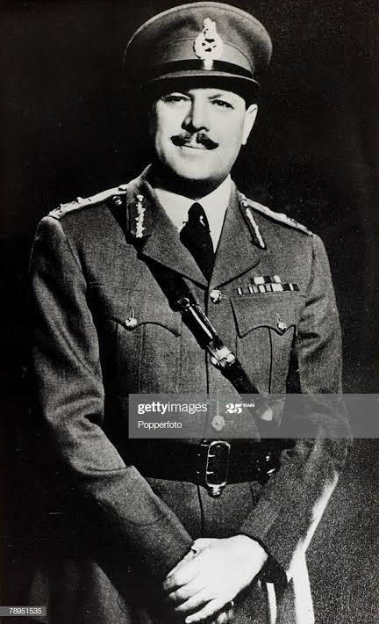
MILITARY DICTATORSHIP: OCTOBER 1958
Field Marshal (self proclaimed) Mohammad Ayub Khan

Slide 13
THE AYUB ERA
1958: Martial Law, preemptive action to stop 1959 parliamentary elections and having majority Bengalis form government
1958 to 1962: Ayub ruled through Punjabi-dominated military and a pliant civil bureaucracy
1962: New Constitution with elections under “Basic Democracy”
Basic Democracy: Indirect elections; President and Parliament elected through an Electoral College of 80,000 Basic Democrats
Patronage to Basic Democrats ensured Ayub Khan victory in elections in 1964-65

Slide 14
1962: MOVEMENT AGAINST AYUB’S EDUCATION POLICY
1962: S. M. Sharif Education Commission publishes its report
  Urdu should be made the language of the people of Pakistan
  English should be made compulsory from fourth grade
  No free primary education
  Education not to be subsidized
Strong student movement against Sharif Commission Report September 17, 1962: 3 killed in police firing

Slide 15
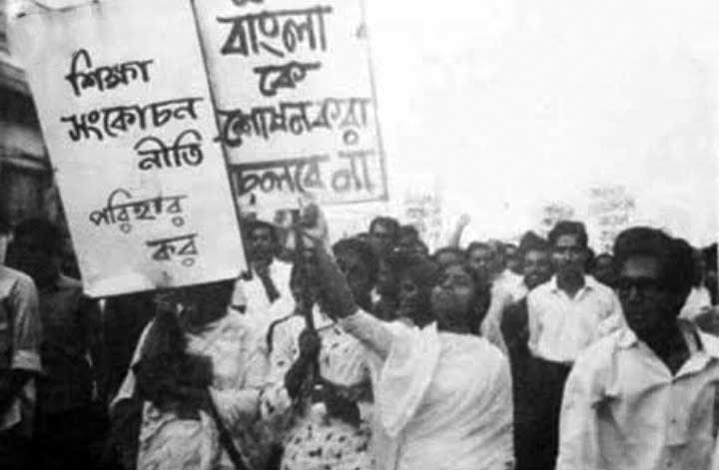
1962: MOVEMENT AGAINST AYUB’S EDUCATION POLICY

Slide 16
THE AYUB ERA
1965: disastrous war with India over Kashmir; East Pakistan left defenseless
Dissatisfaction with continued disparity intensifies Bengali opposition to Pakistan government
1966: Six Point Demand by Sheikh Mujibur Rahman
The intellectual basis of Six Points was the idea of two economies propounded by Bengali economists
1966-1969: Popular protests and mobilization across the country met with severe repression and arrests
1968: Pakistan government frames Agartala Conspiracy Case against Mujib and others with charges of treason

Slide 17
THE AYUB ERA: 6 POINT DEMAND
The Six Point demands were:
Creating provision in the constitution for a Federation of Pakistan in its true sense based on the Lahore resolution
The federal government will deal with only two subjects: Defense and Foreign Affairs
Introduction of two separate, but freely convertible currencies for East and West Pakistan
Vesting the power of taxation and revenue collection with the federating units
Maintaining two separate accounts for the foreign exchange earnings of the two wings and
Creation of a separate militia or paramilitary force for East Pakistan

Slide 18
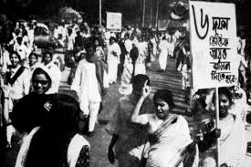
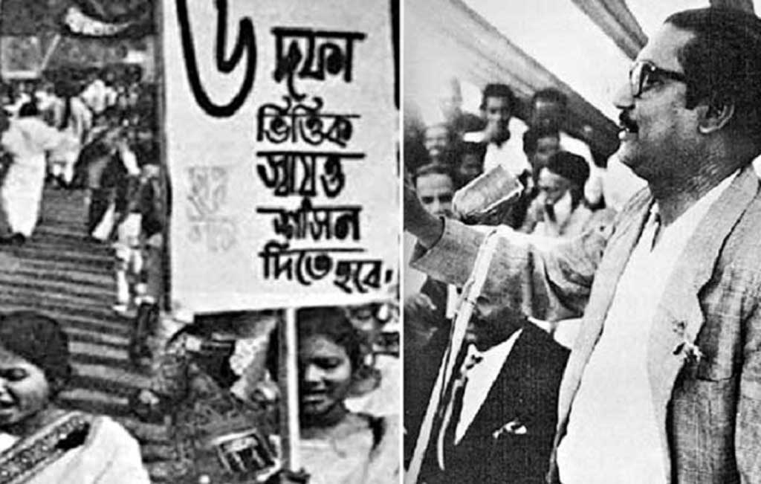
THE AYUB ERA: 6 POINT DEMAND

Slide 19
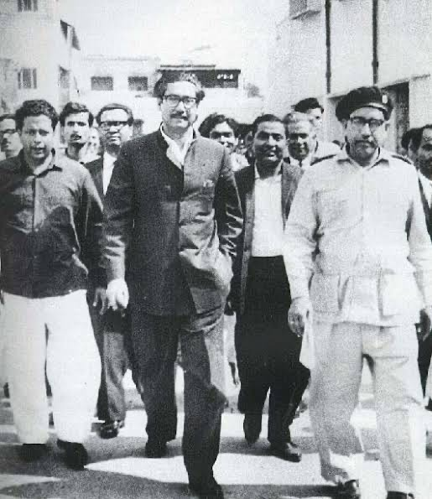
STATE VS. SHEIKH MUJIBUR RAHMAN AND OTHERS

Slide 20
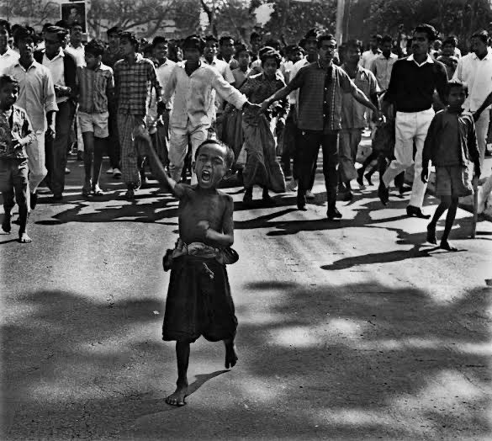
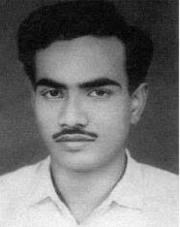
1968-69: THE STREET FIGHTING YEARS

Slide 21
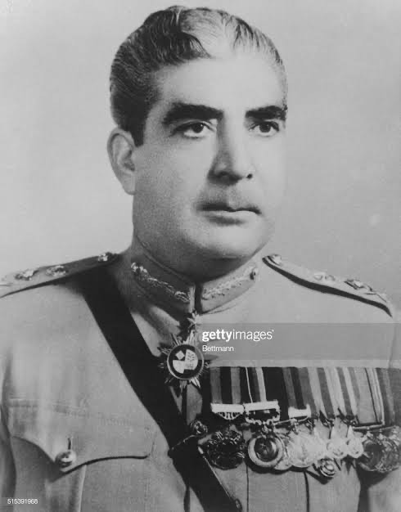
MARCH 25, 1969: MARTIAL LAW AGAIN
General
Agha Muhammad Yahya Khan

Slide 22
THE YAHYA INTERREGNUM
1970 national elections: first ever in undivided Pakistan on the basis of universal adult franchise
Awami League wins 160 out of 162 seats in EP; majority party in 300 seat national assembly with right to form government
November 1970: cyclone hits coastal EP killing 500,000; Pakistan government fails to intervene in relief efforts
Bengalees realize even more the exploitative nature of the Pakistan state and their indifference to the interests of EP
March 1: Yahya postpones convening of National Assembly
Pakistan loses legitimacy in EP; spontaneous demonstrations all over the country;

